Slide 1
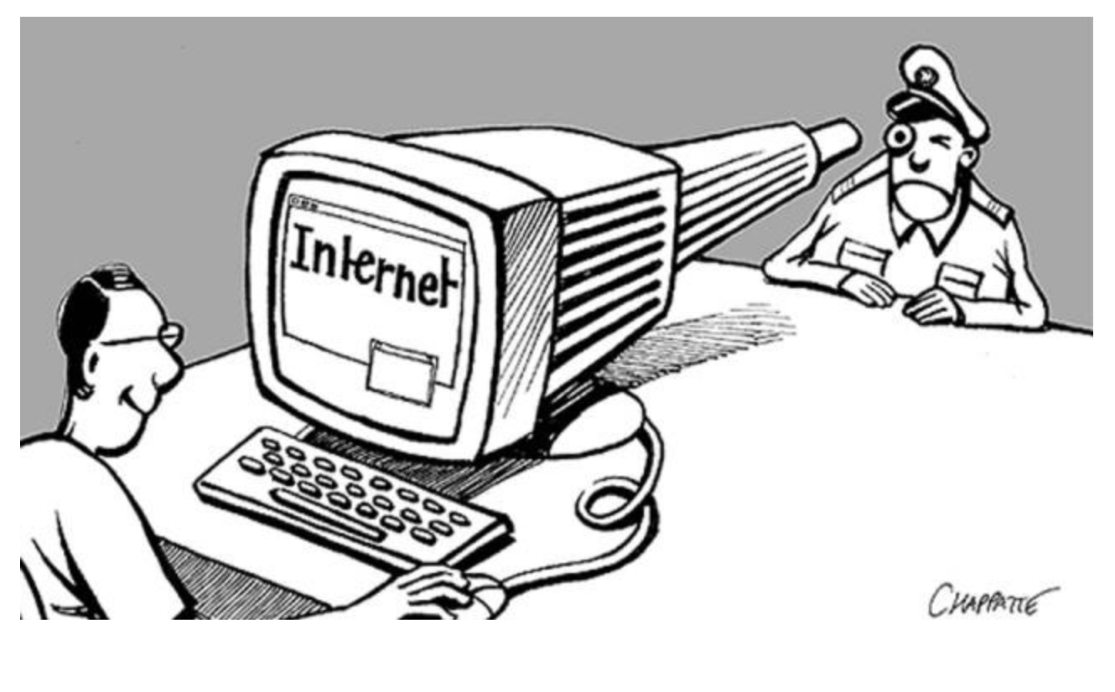
MASS SURVEILLANCE by Mohamed Sondo
CAN WE balance Privacy and Security.?

Slide 2
Outline: Topic MASS SURVEILLANCE Mohamed SOndo
SECURITY VS PRICACY Question
Some Definition:
Privacy
Anonymity
Background: Source : the world After 9/11
Creation of Terrorist Surveillance program?
How Far the Surveillance went?
Who Else is in the Game
What Spy Agency are already Capable of?
Ethical Issues:
What Can Happen if this continue.
How to Protect Yourself Assets: Are things we care About.

Slide 3
SECURITY VS PRICACY Question
The civil liberty fear is that the desire to be safe from terrorism will push aside reason in balancing security versus privacy?
Does the need for security requires us to abandon certain privacy or rights?
How Vulnerable civilian Become when they Privacy are being Violate?

Slide 4

Some Definition: Privacy: no body see what you do and potential knowing who you are. it about content, confidentiality ex: sending encrypted email to a friend

Slide 5
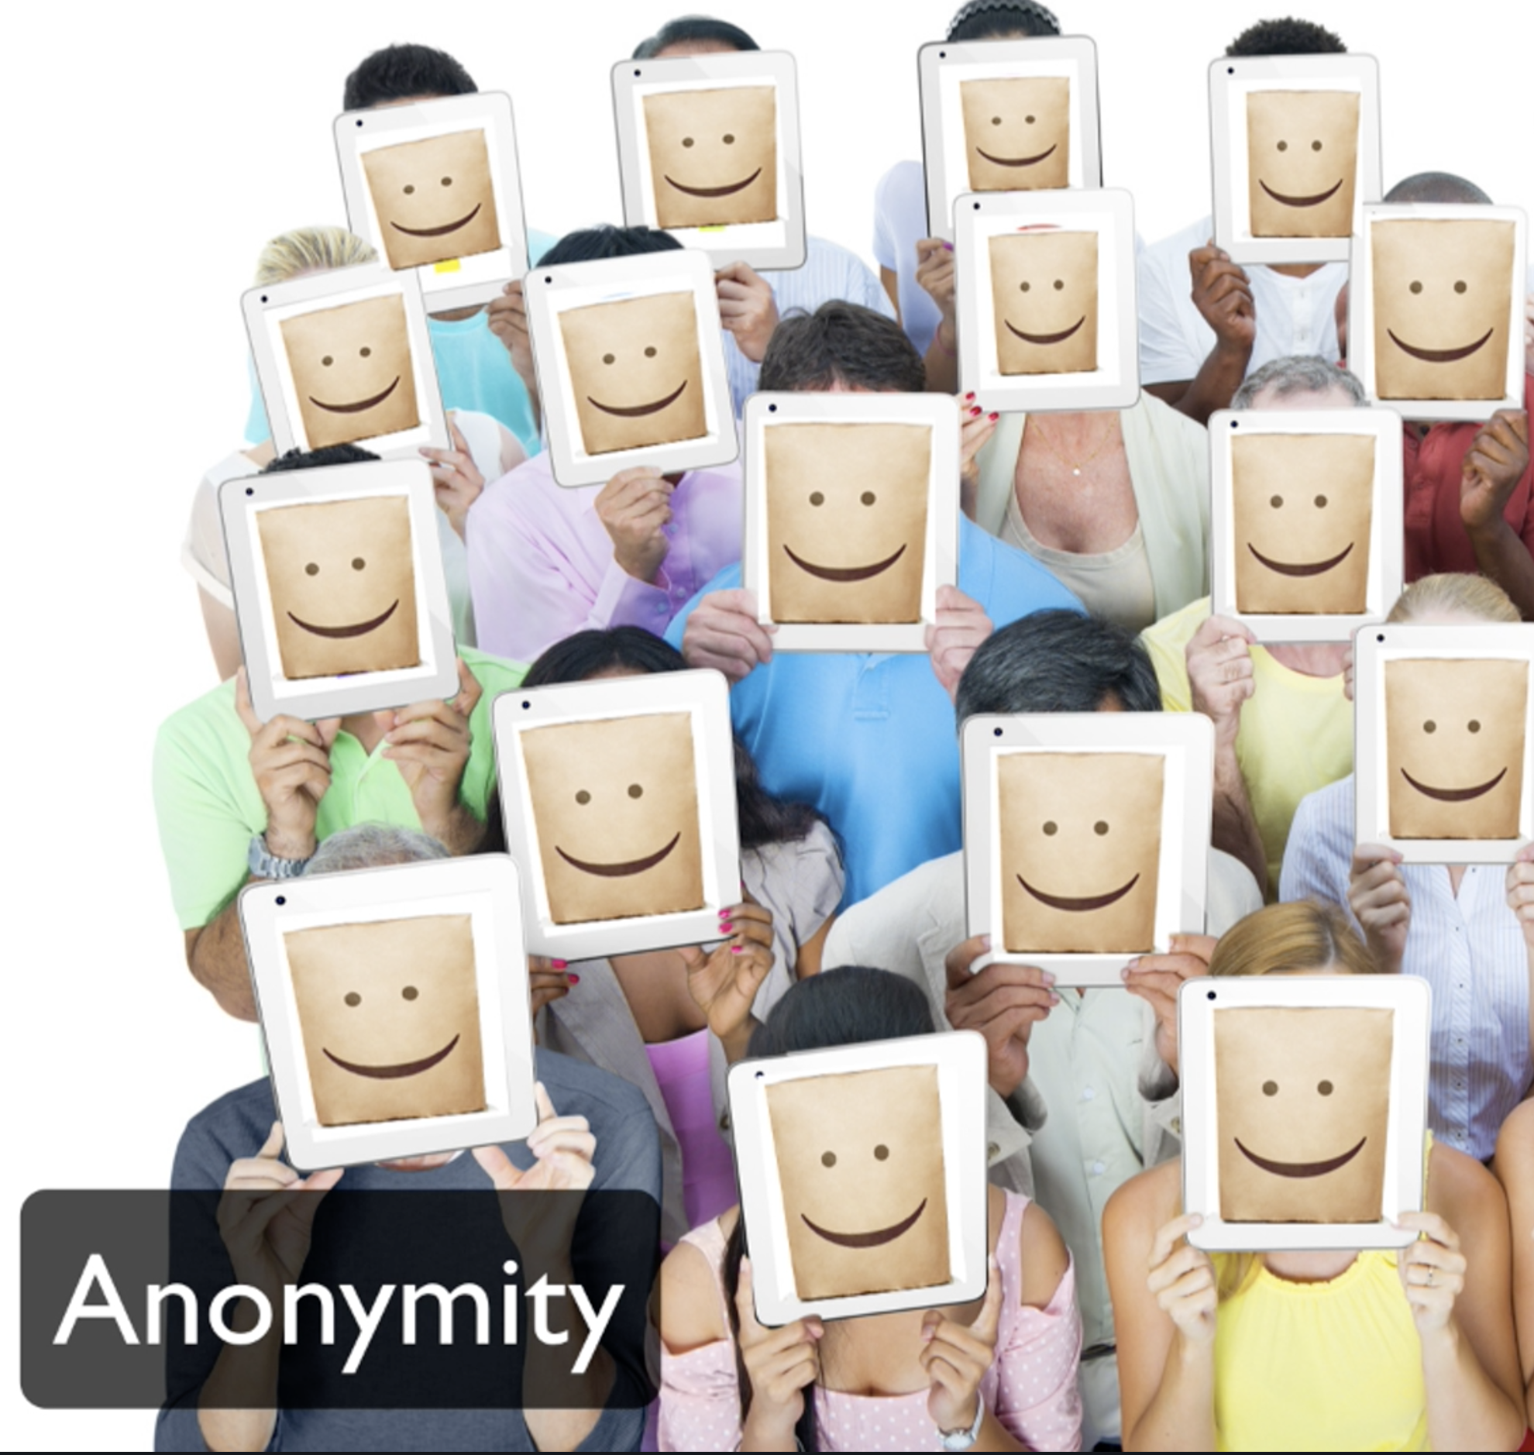
Anonymity: nobody knowing who you are and potentially seeing what you do. keeping your action and activity separate from your true identity . there is an equal chance it could be anyone

Slide 6
Background: Source Terrorism: After 9/11, the Fear of Terrorism Became an Important Question, challenging Nation internal Security.
People Was Eager to make a fear go away, so they demanded More Security.
In the Last decade a lot of civil Liberties has been erodes
Government have taken Steps to Spy on its citizens to collect and store their personal information using any possible means.
This Affect Everyone of Us Regardless of your side.

Slide 7
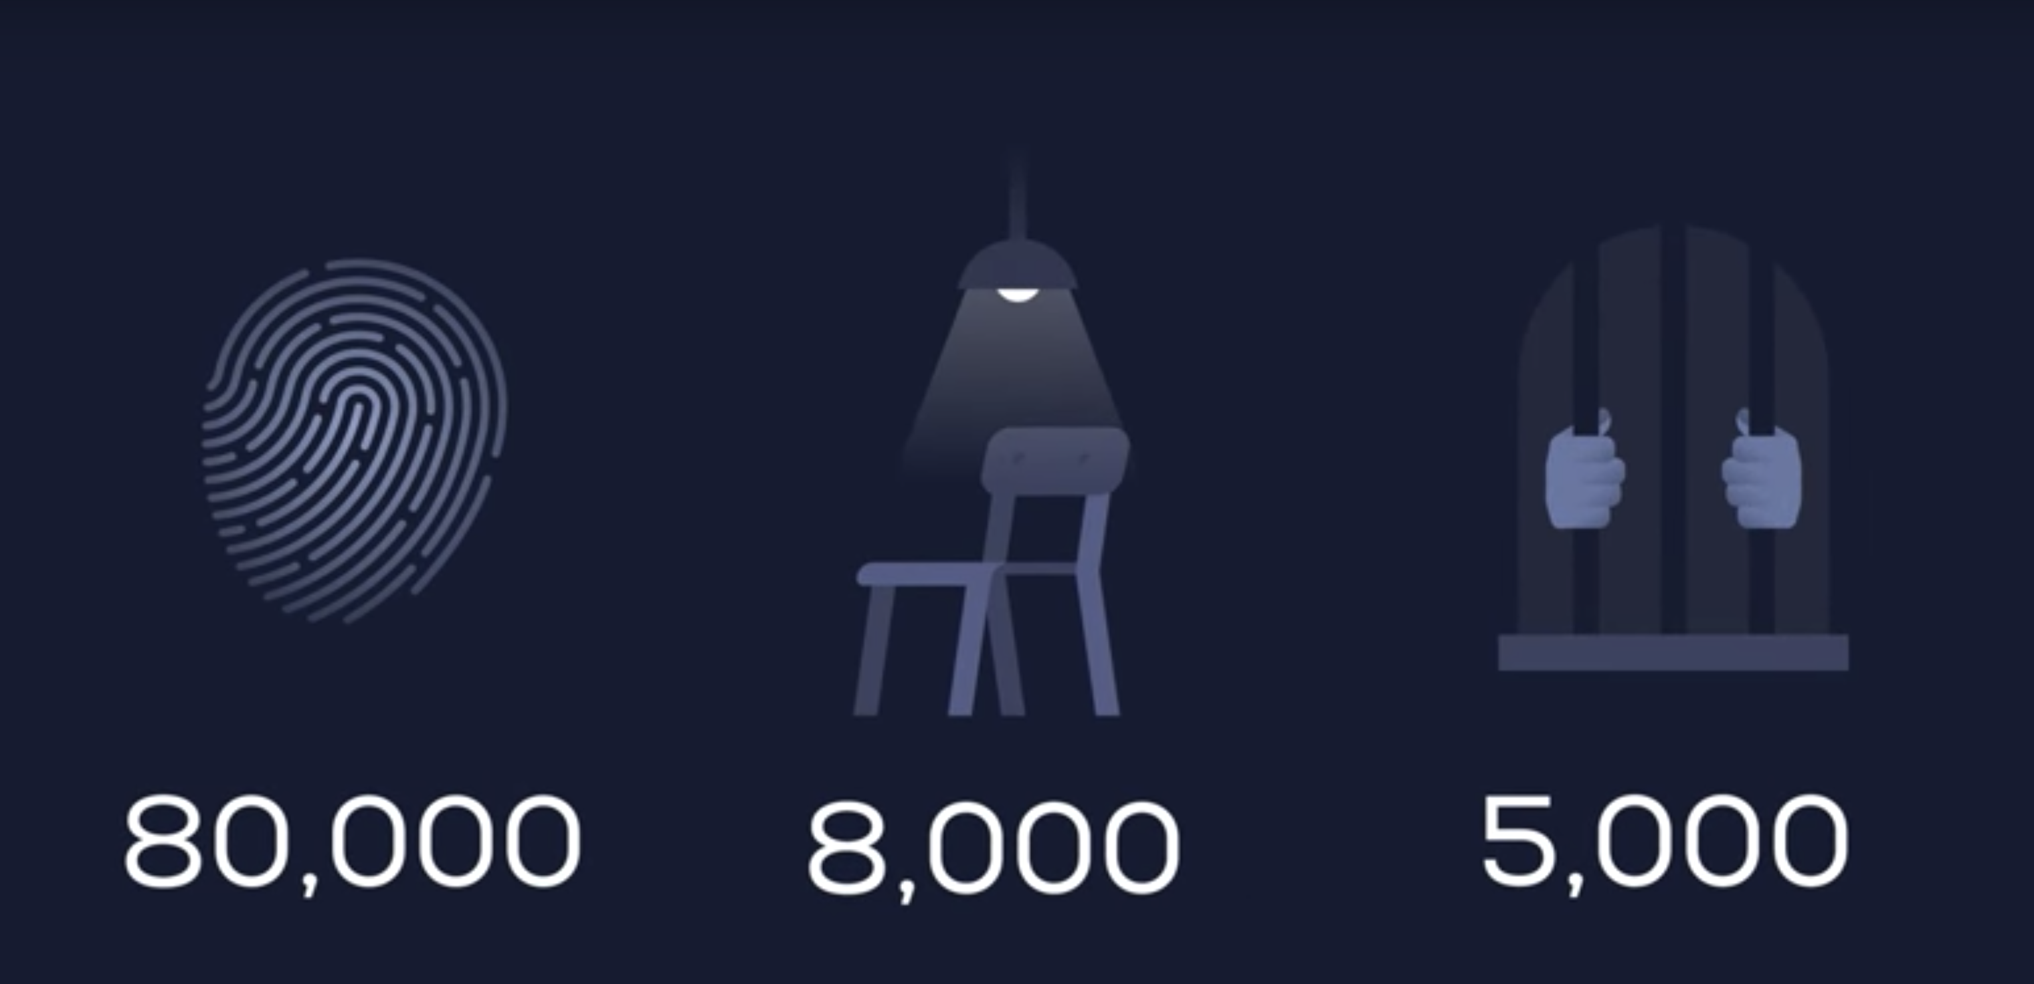
Creation of Terrorist Surveillance program?
Provide Was intended initial to Intercept communication linked to terrorist Organization.
The FBI used Immigration Record to ID Muslim national in US
80000 Required to Register, 8000 for interviews and 5000 lock up in detention
Not 1 terrorist have been in this ethnic profiling

Slide 8
How Far the Surveillance went?
Collection of Data and Surveillance continue on frequent Basis in Secrecy.
All of these collection and Collection and surveillance was later made plain by the leak of of Swnoden Document in 2013.
The Document Showed How the NSA collect users Information from firm like Google, Microsoft and Daily collection of civilian internet traffic( Email content, Contact List)
Instead of Focusing on criminal, governments are turning their Attention to Everyone.
Despite major Efforts, The NSA Surveillance was not effective in preventing future Attack such as the Boston bombing. (One of Boston Bomber was already on FBI list.
The Agency know Used new nean of Data mining to Analyze data Collected.

Slide 9

Who Else is in the Game
Spy Agency are also Pushing to cripple Encryption.
In 2016 The FBI Ask apple to Produce a backdoor program to disable the encryption of a terrorist IPhone. Apple Decline because creating the program will weaken the privacy of law abiding citizens worldwide
Apple fear to open the Floodgate of government Requesting access
To Technology used by Billion of people world Wide.
Few Week Later FBI Reveal that they Have hack the phone which mean Admitting to lied to public about the need of backdoor.
How Trustworthy SPY agency are? And the Debate about Privacy and Security.

Slide 10
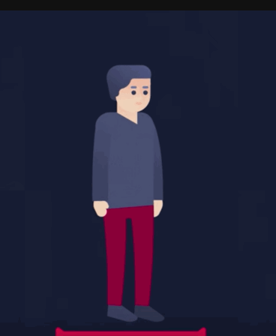
What Spy Agency are already Capable of?
The NSA already have to capability to turn on your iPhone( or other phone)
Microphone, Activate your Laptop Camera without you noticing. Using your Tv and many other consume electronic device that you purchase to spy on you. Screen Video recording, Use of Facial Recognition program in public place and more...
Concern about this Practice are Often met with the Argument “ If you have noting to hide, you have nothing to fear.
Doe Willing to keep certain part of your like private mean you are doing
Anything wrong?
Are these Violating the Violating the principal of democracy

Slide 11
Ethical Issues:
We Have to take look at the Data Being collected from citizens and Ask our self honestly, has all of the Step taken by government made us Safer?
Imagine if analysis of Data collect are used later to oppression people
What if power given to agency are being used for unintended purpose.(In France increase in Anti Terrorism law) was being used to Quash climate change protest.
Government of Spain, Sweden and Hungary have place more restriction of Freedom of Assembly and Speech.
Freedom of Expression and speech has been Undermined in Turkey.(People were Sent to prison for criticizing the Government.
No of these Practice has been proven to effectively fight Terrorism.
The Motivation behind Surveillance program might be good But Letting Government Violate our Privacy, limit our personal Freedom, the Terrorist are winning.

Slide 12
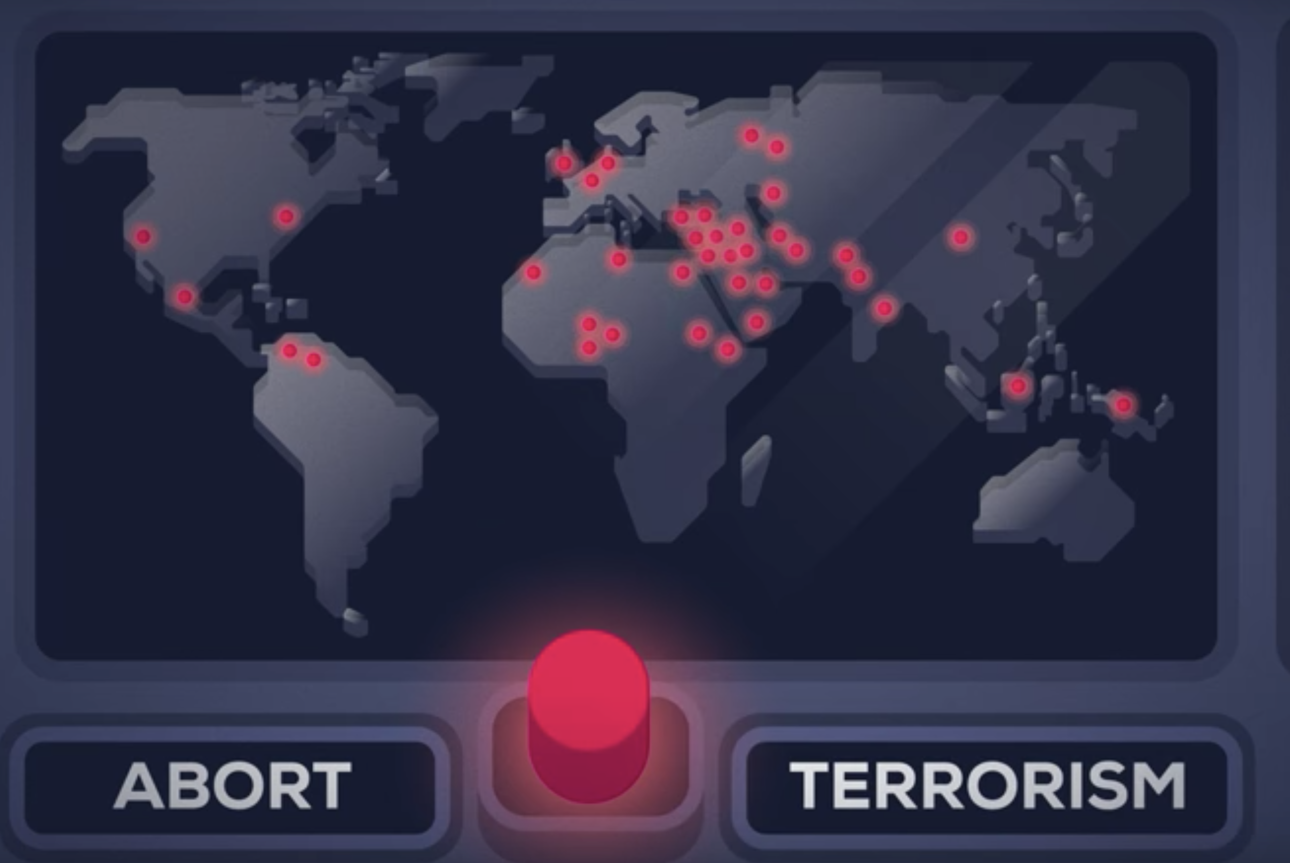
What Can Happen if this continue.
If We are not careful, All of our life will be in surveillance state.
Terrorism is complicated problem without simple solution. We need Better international Cooperation, Better application of present law instead of new one that undermine our Freedom.

Slide 13
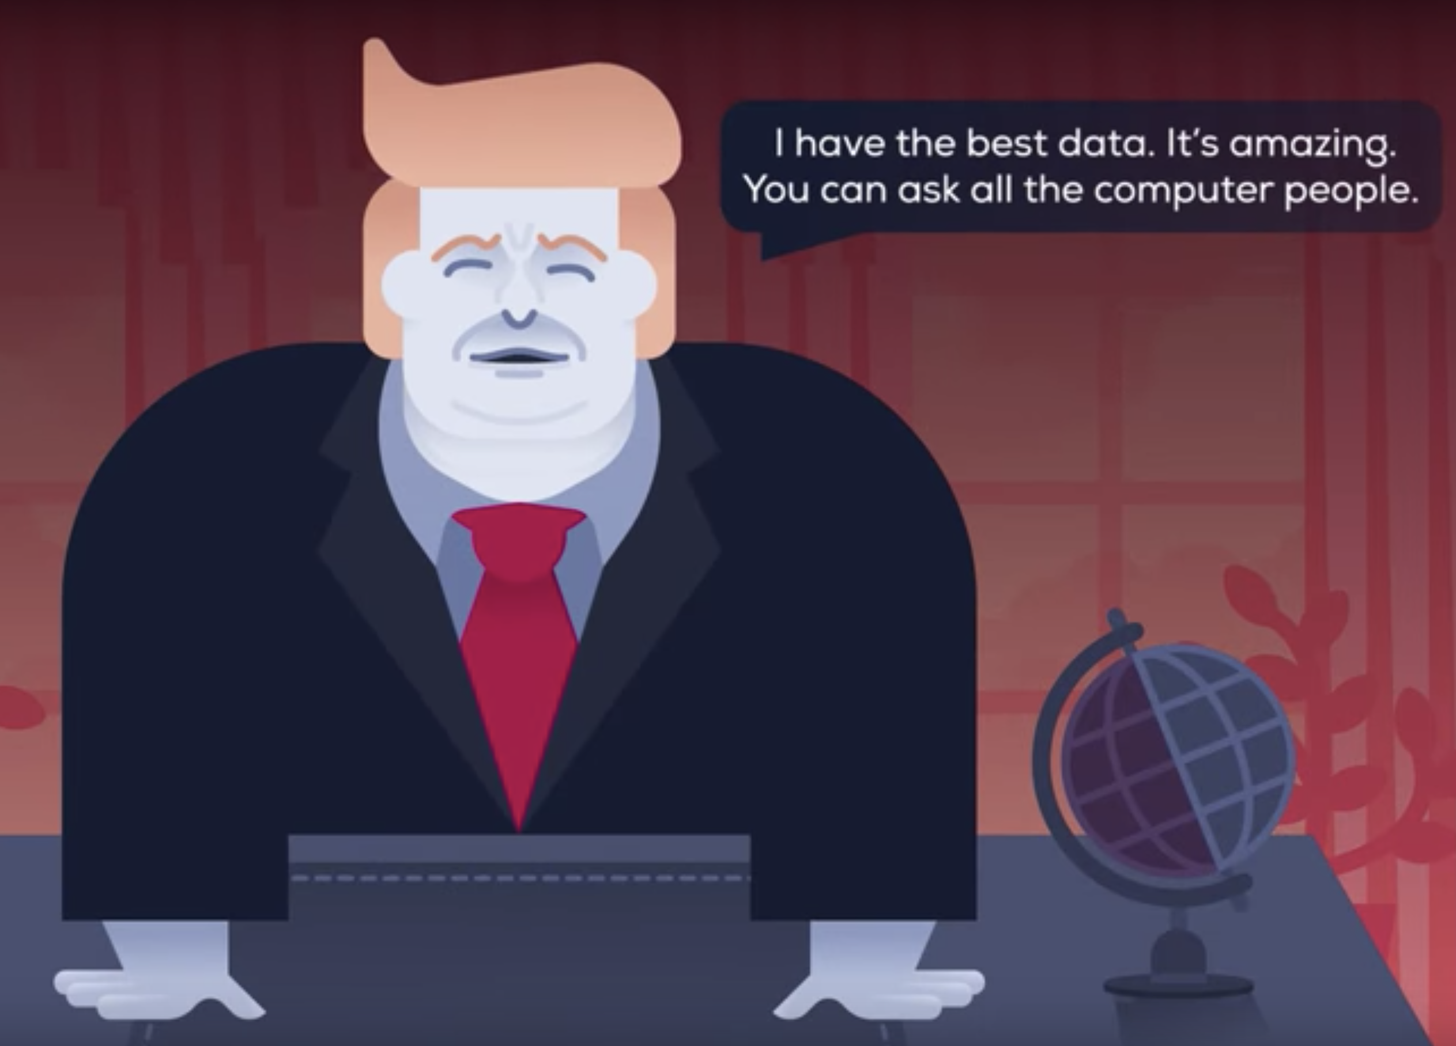
We might Have Oppressive regime

Slide 14
How to Protect Yourself Assets: Are things we care About.
Privacy, Content, File, Identify Anonymity, Activity, location, group and organization, Financial, browsing.
Do protect these Assets, you need to apply security control depend on your need. VPN, HTTPS, Encryption, Tor…
Turn off location in phone, hide your laptop camera, microphone when you don’t need need them,
Remember that Security is the degree to which you Assets are resistant's to threats from Adversary. So select Security Control base on type of Threat(Bad things) and Adversary.

Slide 15
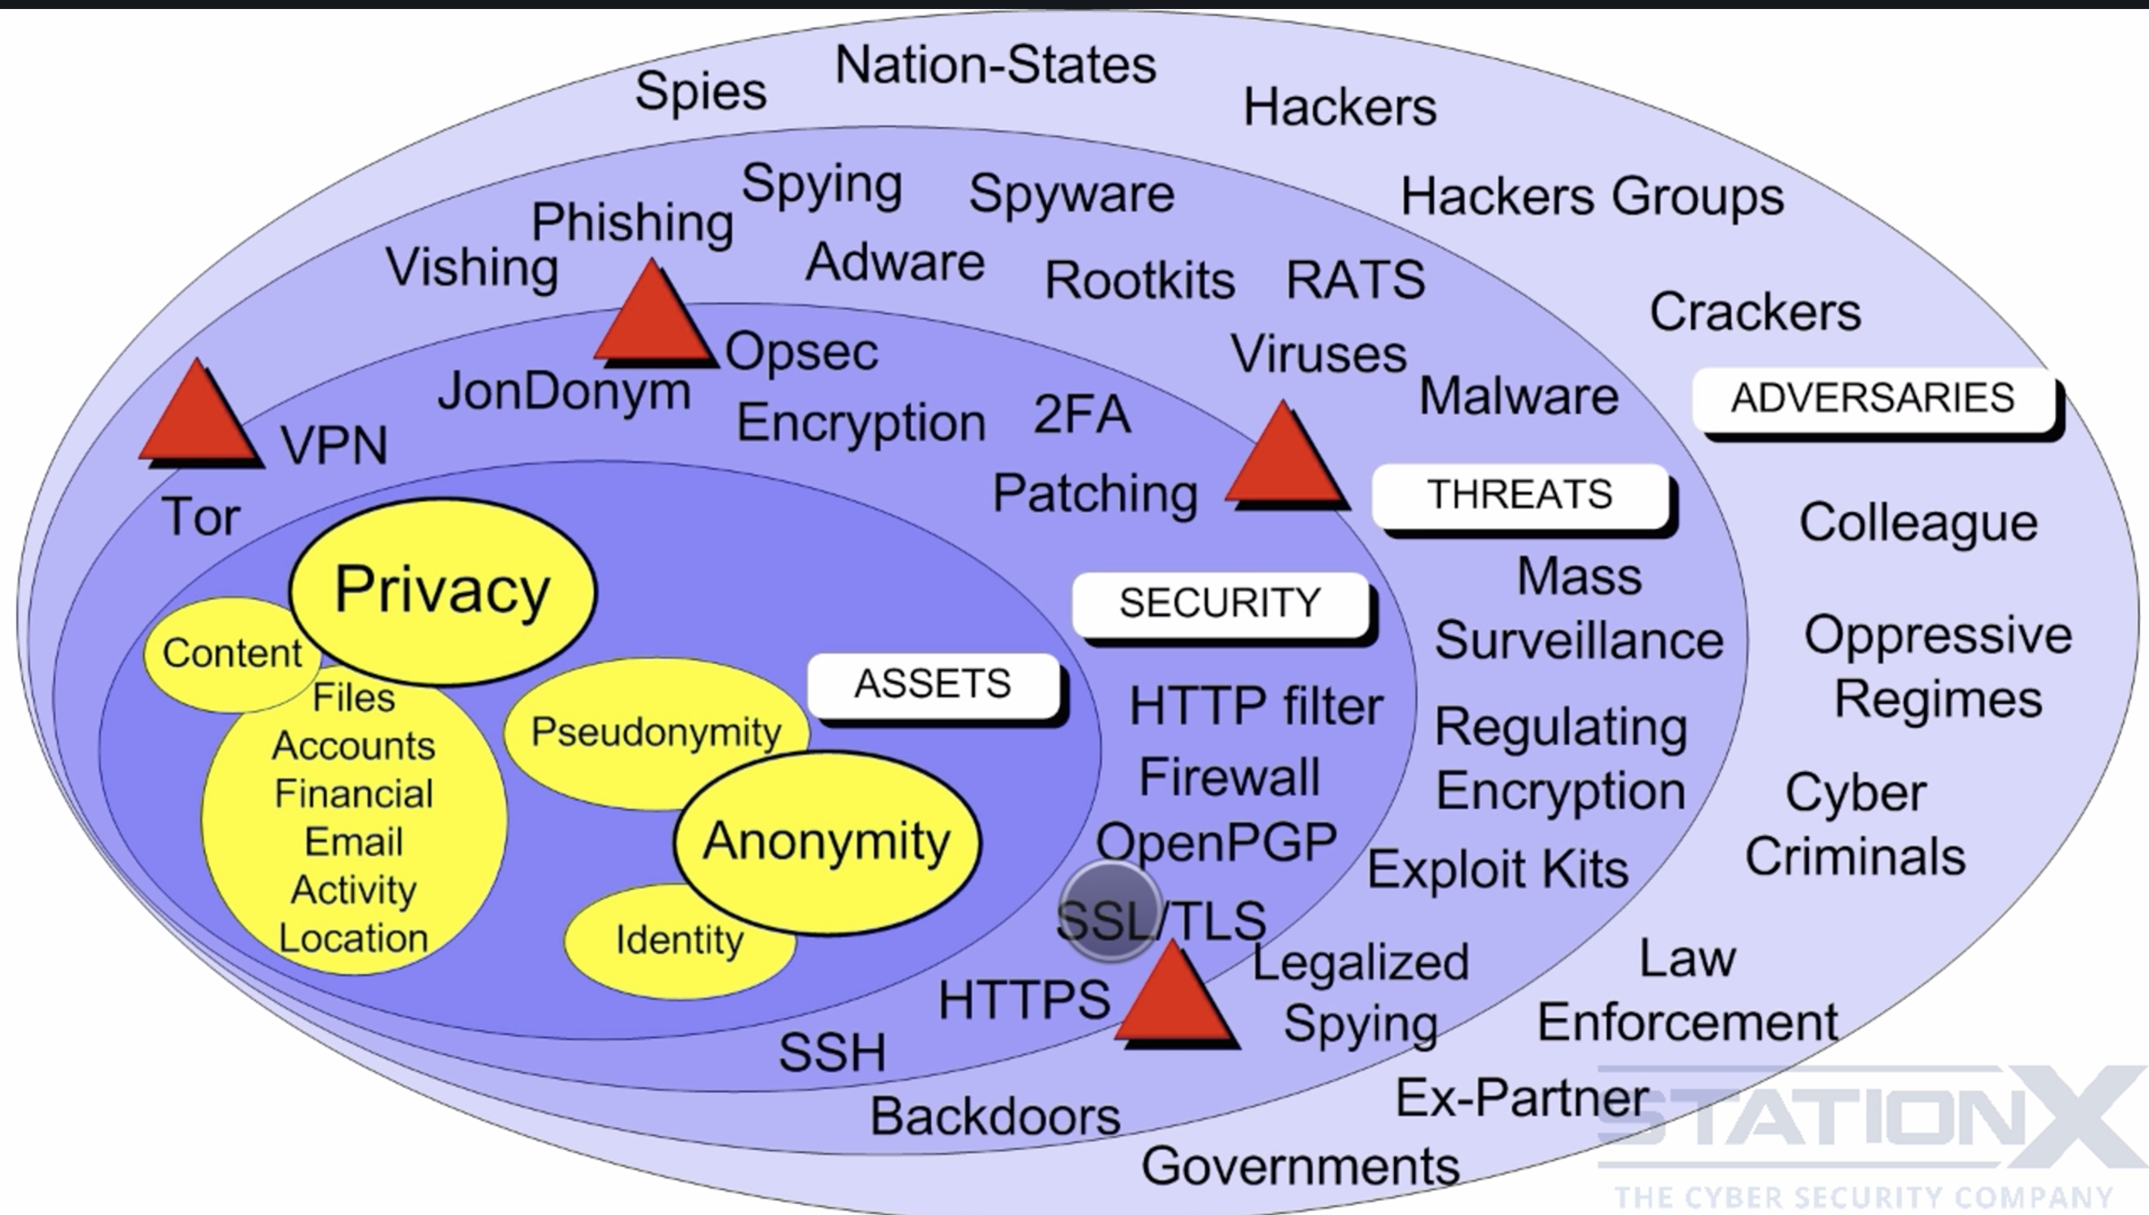
Security Vulnerability and Threats and Adversary

Slide 16
Reference
https://www.liberties.eu
http://kurzgesagt.org/
https://www.theguardian.com/commentisfree/2013/jun/21/obama-national-security-state-rogue
http://theweek.com/articles/463078/snowden-crossed-red-line

